Slide 1
A Brief History of Eternity
The Final Destiny of Man

Slide 2
In the Beginning
“In the beginning God created the heavens and the earth.
And the earth was formless and void, and darkness was over the surface of the deep; and the Spirit of God was moving over the surface of the waters.”
Genesis 1:1–2, NASB

Slide 3
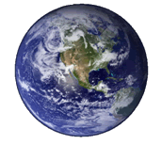
The Earth Becomes Formless and Void

Slide 4
Pre-Creation Chaos Theory
Original Creation
Fall of Satan
Creation/Restoration
John 1:1
Col 1:16-17
Dateless
Ez 28:11-19
Isa 14:12-15
Dateless
Gen. 1:1
10,000 B.C.?

Slide 5
Pre-Genesis 1:1 Universe
Event Horizon

Slide 6
“Without Form and Void”
Event Horizon
The Pre-Genesis 1:1 Earth

Slide 7
The Fall of the Shining One

Slide 8
Every precious stone was your covering: The ruby, the topaz, and the diamond; The beryl, the onyx, and the jasper; The lapis lazuli, the turquoise, and the emerald;
And the gold, the workmanship of your settings and sockets, Was in you. On the day that you were created They were prepared."
Ezekiel 28:13

Slide 9
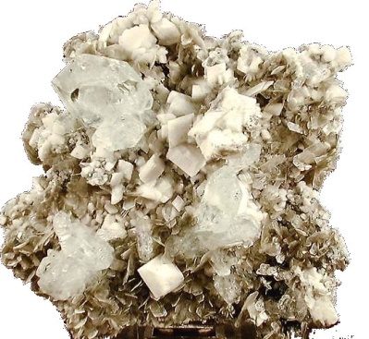
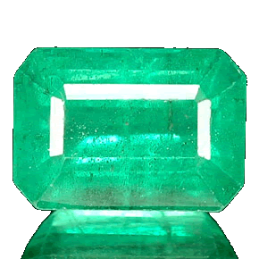
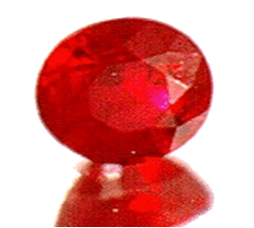
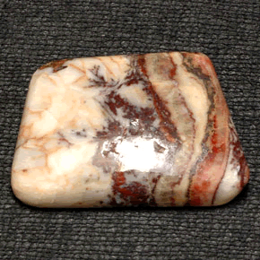
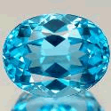
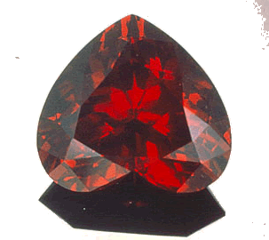
Reflecting God’s Glory
Onyx
Sapphire
Beryl
Emerald
Sardis
Topaz
Jasper
Diamond
Garnet

Slide 10
“You were the anointed cherub who covers, And I placed you there. You were on the holy mountain of God; You walked in the midst of the stones of fire. “You were blameless in your ways From the day you were created, Until unrighteousness was found in you."
Ezekiel 28:14-15

Slide 11
12 Statements About Satan
1. Model of Perfection (v. 12)
2. Full of Wisdom
3. Perfect in Beauty
4. Ruled from Pre-Genesis 1:2 Eden, v. 13 - “sanctuaries” = holy places (v. 18)
5. Reflected God’s Glory

Slide 12
12 Statements About Satan
1. Model of Perfection (v. 12)
2. Full of Wisdom
3. Perfect in Beauty
4. Ruled from Pre-Genesis 1:2 Eden, v. 13
5. Reflected God’s Glory
6. Worshipped God Perfectly

Slide 13
12 Statements About Satan
7. A Mighty Angel, 14
8. Ruler of the Pre-Genesis 1:2 Universe
9. Walked in the Presence of God
10. Perfect in all His Ways, v. 15
11. He is a created being
12. Unrighteousness was found in him

Slide 14
His Pride (vv. 16-17)
The Sin of Pride, v. 17-18 “Your heart was lifted up because of your beauty; You corrupted your wisdom by reason of your splendor.”

Slide 15
The Divine Response
“We shall give this rebellion a thorough trial. We shall permit it to run its full course. The universe shall se what a creature, though he be the highest creature ever to spring from God'’ Word, can do apart from Him. We shall watch this experiment, and permit the universe of creatures to watch it, during this brief interlude between eternity past and eternity future called time. In it the spirit of independence shall be allowed to expand to the utmost. And the wreck and the ruin which shall result will demonstrate to the universe, and forever, that there is no life, no joy, no peace apart from a complete dependence upon the Most High God, Possessor of heaven and earth.”
Donald Barnhouse, The Invisible War, p. 51

Slide 16
Summary of the Invisible War
The universe gives evidence that it was designed. It “knew” we were coming. We are uniquely located to observe this design and see God’s glory.
The Trinity was in loving communion in eternity past and conceived a perfect plan. The Shining One was created as God’s perfect one, his viceroy.
The Shining One Fell and became the Satan (the Adversary)
God plants a an inferior creature (man) in the Satan’s world, Adam fell, and the Invisible War begins.

Slide 17
Why didn’t God smash Satan immediately?
He chose to enact a plan in which he would involve Himself in the consequences of this rebellion and fully endure its pain. In this way he demonstrates exactly the opposite of what Satan practiced. It is by humility and dependence that life and meaning are found and that the highest honors are gained.

Slide 18
Earth Belongs to Satan
﻿﻿And he led Him up and showed Him all the kingdoms of ﻿﻿﻿﻿the world in a moment of time.
And the devil said to Him, “I will give You all this domain and ﻿﻿its glory; ﻿﻿for it has been handed over to me, and I give it to whomever I wish.
“Therefore if You ﻿﻿worship before me, it shall all be Yours.”
Jesus answered him, “It is written, ‘﻿﻿You shall worship the Lord your God and serve Him only.’ ”
Luke 4:5-7

Slide 19
This World Belongs to Satan
“Now judgment is upon this world; now the ruler of this world shall be cast out.” (John 12:31)
“in whose case the god of this world has blinded the minds of the unbelieving, that they might not see the light of the gospel of the glory of Christ, who is the image of God.” (2 Corinthians 4:4)
“in which you formerly walked according to the course of this world, according to the prince of the power of the air, of the spirit that is now working in the sons of disobedience.( Ephesians 2:2)

Slide 20
God’s Offensive Force
Reflect His Image:
Then God said, “Let Us make man in Our image, according to Our likeness;
Rule over the Satan’s world:
and let them rule over the fish of the sea and over the birds of the sky and over the cattle and over all the earth, and over every creeping thing that creeps on the earth.”
Gen 1:26

Slide 21
God’s Offensive Force
Reproduce a Godly Seed
27 And God created man in His own image, in the image of God He created him; male and female He created them. V. 27
God blessed them; and God said to them, “﻿﻿Be fruitful and multiply, and fill the earth, and subdue it; v. 28

Slide 22
The Quest for Meaning
Ancient World
Certain knowledge
Mediaeval World
Forgiveness
Modern World
Meaning

Slide 23
To Manifest His Glory
Eternal Purpose

Slide 24
The Manifestation of His Glory
For from Him and through Him and to Him are all things. To Him be the glory forever. Amen.
Romans 11:36
“For the earth will be filled With the knowledge of the glory of the Lord, As the waters cover the sea.
Habakkuk 2:14

Slide 25
To Establish His Rule
To Manifest His Glory
Creation Purpose
Eternal Purpose

Slide 26
His Creation Purposes
To Establish His Rule and Destroy the Works of the Devil
To Establish the Futility of Independence and Unbelief
To Model and Participate in a Moral Response to the Satan’s Challenge

Slide 27
The Humility of Christ
Who, being in very nature﻿﻿ God, did not consider equality with God something to be grasped,
but made himself nothing, taking the very nature﻿﻿ of a servant, being made in human likeness.
And being found in appearance as a man,
he humbled himself and became obedient to death— even death on a cross!
Therefore God exalted him to the highest place and gave him the name that is above every name,
that at the name of Jesus every knee should bow,
in heaven and on earth and under the earth,
and every tongue confess that Jesus Christ is Lord,
to the glory of God the Father.
Php 2:6-11

Slide 28
The Hinge of History
The Shining One
The Lord Jesus Christ
A creature
Demanded his rights
Sought to be like God
Destruction
The Nature of God
Did not grasp onto his rights
Became like those he came to serve
Exaltation

Slide 29
To Raise up a Multitude of Servant Kings
To Establish His Rule
To Manifest His Glory
Creation Purpose
Eternal Purpose
Redemption Purpose

Slide 30
His Redemption Purpose
To Raise up a Multitude of Servant Kings to Rule the New Heavens and the New Earth

Slide 31
Man is to rule!
When I consider your heavens,
the work of your fingers,
the moon and the stars,
which you have set in place,
what is man that you are mindful of him,
the son of man that you care for him?
You made him a little lower than the heavenly beings﻿﻿ and crowned him with glory and honor.
"You made him ruler over the works of your hands; you put everything under his feet:”
Ps 8:3-6, NIV

Slide 32
The Way of the Servant Kings
﻿﻿But Jesus called them to Himself and said, “You know that the rulers of the Gentiles lord it over them, and their great men exercise authority over them.
“It is not this way among you, ﻿﻿but whoever wishes to become great among you shall be your servant,
and whoever wishes to be first among you shall be your slave;
just as ﻿﻿the Son of Man ﻿﻿did not come to be served, but to serve, and to give His ﻿﻿life a ransom for many.”
Mt 20:25-28

Slide 33
The Biblical Philosophy of History
Starting Point: Creation (Gen 1)
Controlling Principle: Out of the least, God will bring the greatest (Heb 2:5-9)
Goal: The Establishment of His Rule (1 Cor. 15:26)

Slide 34
The Keys to Purpose in Life
The Divine Purpose | My Life Purpose | Scripture
His Eternal Purpose: The manifestation of His Glory | How will this thought or action make God known? | 1 Cor. 10:31; Hab 2;14
His Creation Purpose: To demonstrate the superiority of faith and servant hood over independence and unbelief | How am I living by faith today? How am I serving and deferring to others today? | Heb . 11:6
His Redemption Purpose: To raise up a multitude of Servant Kings who will manifest his way of life and one day rule in the Kingdom and in the New Heaven and New Earth | Am I pursuing the Kingdom Way of Life as taught in the Sermon on the Mount? How am I living with the “end in view? | Mt. 20:25-28 2 Cor 5:10

Slide 35
Not all Christians will enter into the fulfillment of human destiny
Luke 19:12-27 - 5 Cities/10 Cities

Slide 36
The Parable of the Minas
And it came about that when he returned, after receiving the kingdom, he ordered that these slaves, to whom he had given the money, be called to him in order that he might know what business they had done.“And the first appeared, saying, ‘Master, your mina has made ten minas more.’“And he said to him, ‘Well done, good slave, because you have been faithful in a very little thing, be in authority over ten cities.’“

Slide 37
The Parable of the Minas
“And another came, saying, ‘Master, behold your mina, which I kept put away in a handkerchief; for I was afraid of you, because you are an exacting man; you take up what you did not lay down, and reap what you did not sow. ’“He *said to him, ‘By your own words I will judge you, you worthless slave. Did you know that I am an exacting man, taking up what I did not lay down, and reaping what I did not sow?‘Then why did you not put the money in the bank, and having come, I would have collected it with interest?’ “And he said to the bystanders, ‘Take the mina away from him, and give it to the one who has the ten minas.’ “And they said to him, ‘Master, he has ten minas already.’ “I tell you, that to everyone who has shall more be given, but from the one who does not have, even what he does have shall be taken away
Luke 19:20–27, NASB

Slide 38
Not all Christians will enter into the fulfillment of human destiny
Luke 19:12-27 - 5 Cities/10 Cities
2 Cor 5:10-11 - Reward – for good /bad

Slide 39
The Judgment Seat of Christ
For we must all appear before the judgment seat of Christ, that each one may be recompensed for his deeds in the body, according to what he has done, whether good or bad. Therefore knowing the fear of the Lord, we persuade men, but we are made manifest to God; and I hope that we are made manifest also in your consciences.”
2 Corinthians 5:10–11, NASB

Slide 40
Not all Christians will enter into the fulfillment of human destiny
Luke 19:12-27 - 5 Cities/10 Cities
2 Cor 5:10-11 - Reward – for good /bad
Heb 3:13 - Christ’s Metochoi

Slide 41
Christ’s Metochoi
“For we have become partakers of Christ, if we hold fast the beginning of our assurance firm until the end;”
Hebrews 3:14, NASB

Slide 42
How do we Become one of Christ’s Metochoi?
By entering into the kingdom way of living and life as taught in the Sermon on the Mount.

Slide 43
Satisfied!
All My Life I had a longing, but now I’m

Slide 44
Satisfied
All my lifelong I have panted
For a drink from some clool spring,
That I hoped would quench the burning
Of the thirst I felt within.
Feeding on the husks around me,
Till my strength was almost gone,
Longed my soul for something better,
Only still to hunger on.
Chorus Hallelujah!
I have found Him my who soul so long has craved!
Jesus satisfies my longings,
Thro’ His blood I now am saved.

Slide 45
Let’s just listen to this verse.

Slide 46
Satisfied
OK … let’s sing it!
Chorus Hallelujah!
I have found Him who my soul so long has craved!
Jesus satisfies my longings,
Thro’ His blood I now am saved.

